Slide 1
Coundon Primary School Year 2 English Home Learning Week commencing 8.6.20

Slide 2
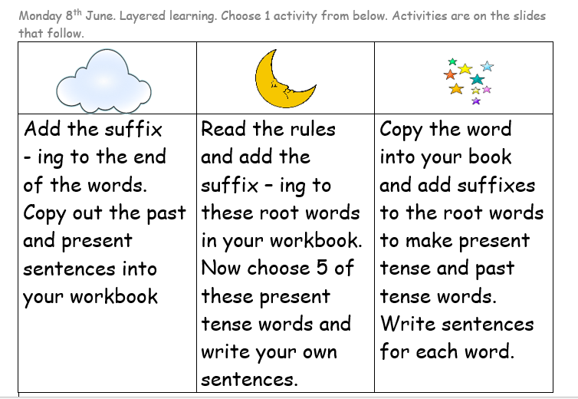

Slide 4
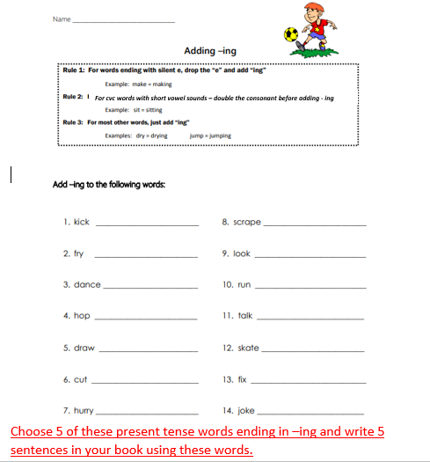

Slide 5
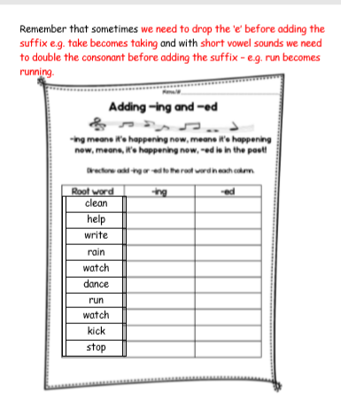
Take each of the words and write one sentence in the present tense and
then one sentence in the past tense.
Eg
I am cleaning the car for my dad.
Yesterday I cleaned the car for my dad.

Slide 6
We are starting a new unit of work on Traction Man!
There are videos on YouTube of the book being read.
https://www.youtube.com/watch?v=0JySea288Qo
In addition the book is available on a separate pdf that we have uploaded to the blog page.
You may need to download the pdf of the book to help you whilst doing this unit of work over the next couple of weeks.

Slide 7
Day 2 Tuesday 9th June
We are starting a new unit of work.
We are going to start looking at this lovely
book by Mini Grey called Traction Man is here.
Click here to watch and listen to the story.
Let’s Chat
to your grown up or brothers or sisters.
What did you think about this book?
What did you notice about the way the book is written? (It is in the present tense)
How does this book differ from other adventure stories you have read?
How do the pictures and thought bubbles help?
In your workbook answer these questions.
What did you like about the book?
What did you dislike about the book?
How does it make you feel?
Remember to use the word because to justify your views.
https://www.youtube.com/watch?v=0JySea288Qo

Slide 8
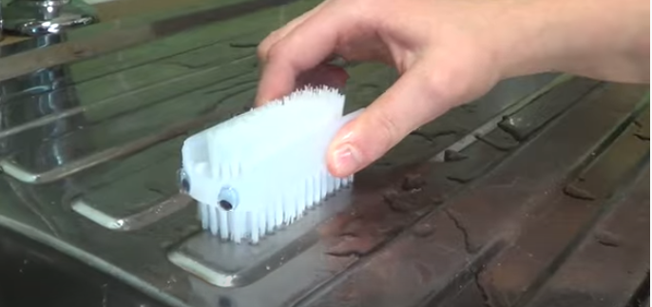
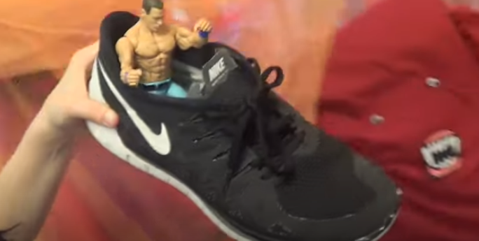
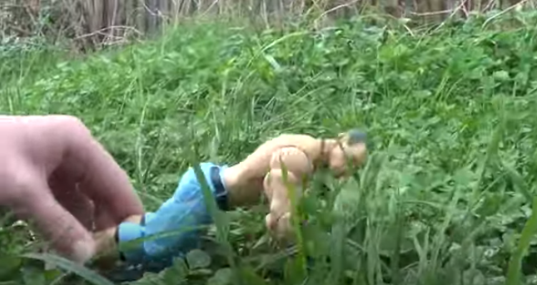
Day 3 Wednesday 10th June
Traction Man uses everyday household objects to carry out his adventures.
Today you need to read or watch the story again so you become more familiar with it.
Now lets see if you can find some of the objects Traction man uses and act out part of the story. Perhaps you have an action figure you could use? You could send your teachers a video clip of your drama or a photograph. We look forward to seeing what you do!
If you want some ideas watch by clicking here
https://www.youtube.com/watch?v=arJy0MFg9c4

Slide 9
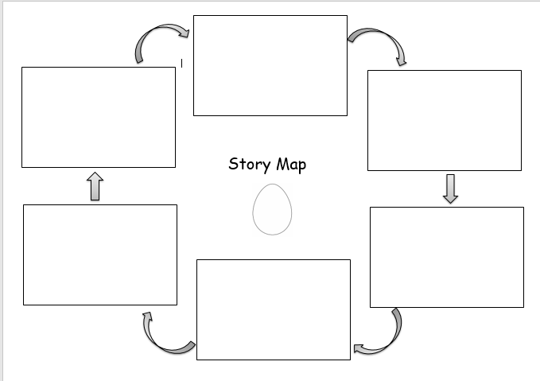
Day 4 Thursday 9th June – Choose one of these activities.
A) A story map OR
B) Complete the table on the next slide.
In your workbook can you draw a story map to show Traction mans adventures. You will need to use this to retell the
story so it might help to add a few words and phrases . You can find the story text on slide 10 to help you.

Slide 10
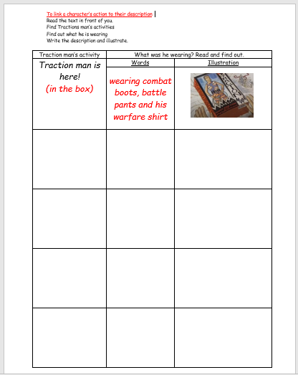
Day 4 continued Activity B
Look on slide 10 for the story text to help
you OR read the book on the pdf slideshow.

Slide 11
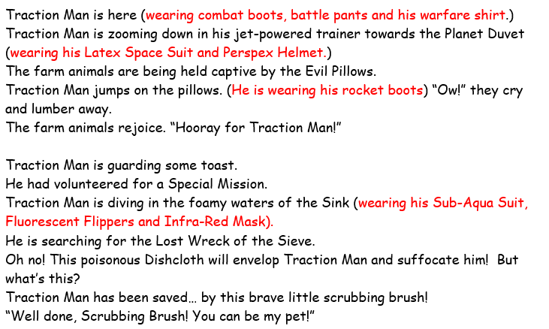
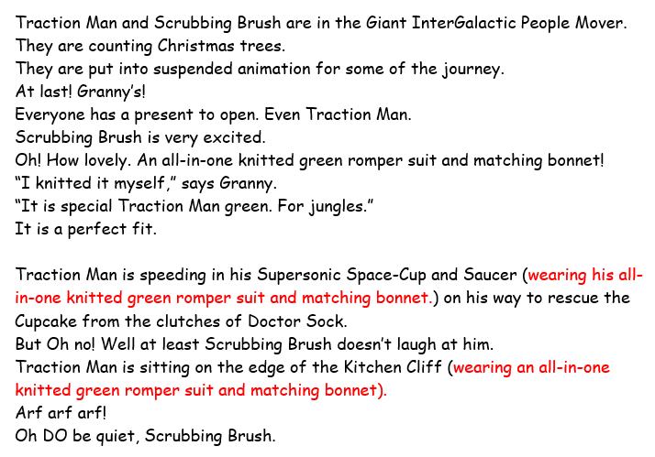
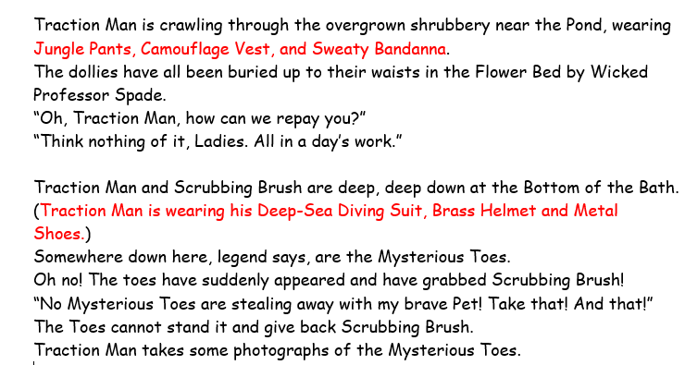
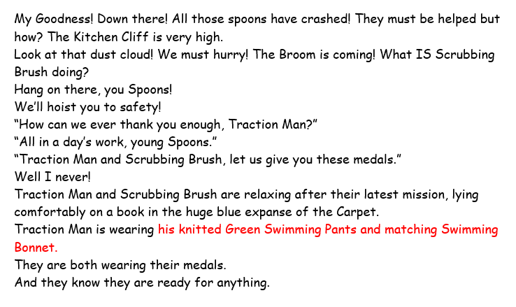
3
1
2
4

Slide 12
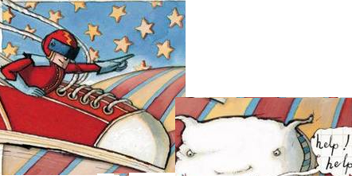
Day 5
What is going on here? How can Traction Man help?
How do you think Traction Man might
talk to the characters who are in
trouble?
What might he say?
(I have had a little go and wrote what I thought he might say in the speech bubble!)
Never fear animals! I’m on my way to rescue you from the evil pillows!
REMINDER!
When you write in a speech bubble you do NOT need inverted commas
(speech marks)
Think of what Traction man could say in the speech bubbles on the next slide.

Slide 13
