Slide 1
Coundon Primary School Year 2 English Home Learning Week commencing 15.6.20

Slide 2
Traction Man Part 2
Last week we read ‘Traction Man is Here’ and
watched the YouTube video too.
Below is a link to a video in case you missed the work
last week. There is also a separate PDF of the book
on the blog for you to read with your child.
https://www.youtube.com/watch?v=0JySea288Qo

Slide 3
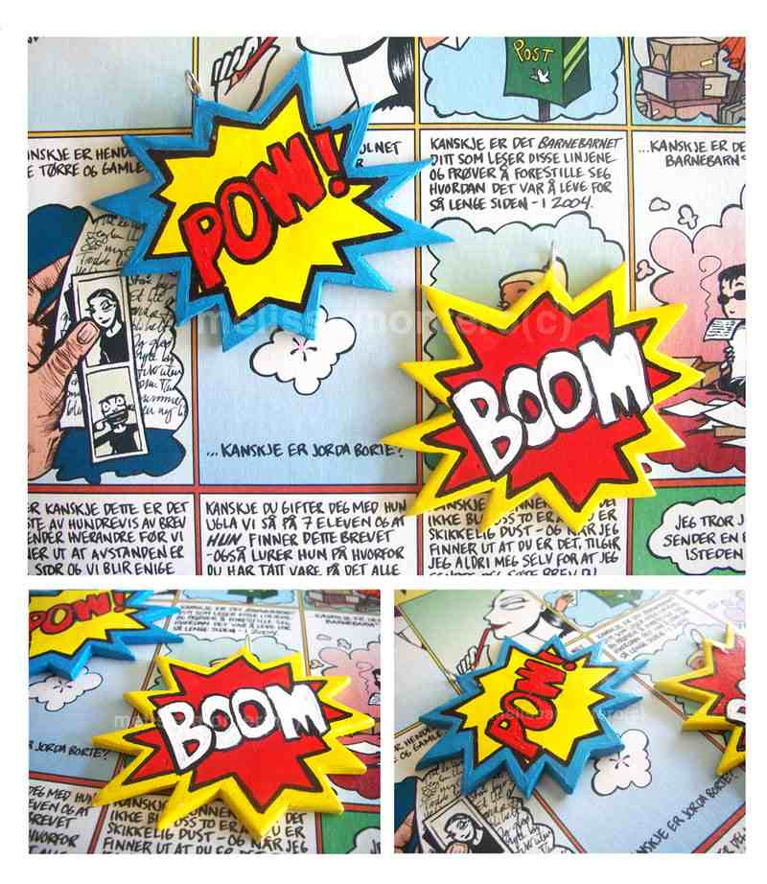
Traction Man's Warfare Shirt is covered in examples of onomatopoeia.
What on earth is Onomatopoeia?
Onomatopoeia is the name given to words which imitate a sound.
Onomatopoeia is often
found in poetry and comics.

Slide 4
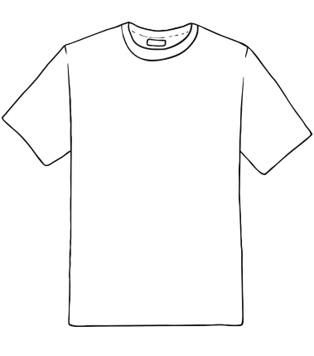
Monday’s Task
You can write a list of some onomatopoeic words
in your book or print off a T-shirt and cover it
with onomatopoeic words.

Slide 5
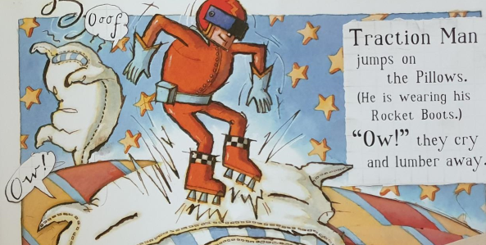
Tuesday’s Task
Traction man performs actions. A verb is an action word.
List some of the verbs used in the story and use this to create a collection of vocabulary that you can use in your own writing. I have looked at the text on the next slide to help me. You can use that OR the separate pdf of the book.
Write a list in your workbook. How many can you find?
Traction man is……….
zooming
jumps
guarding
diving

Slide 6
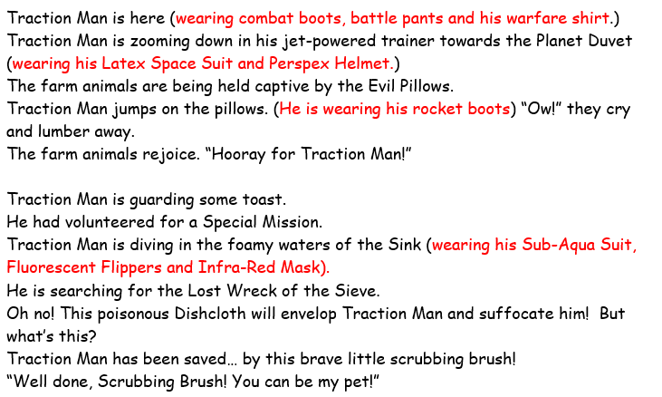
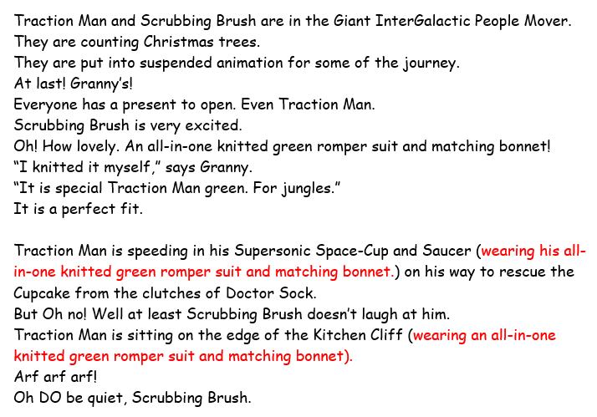
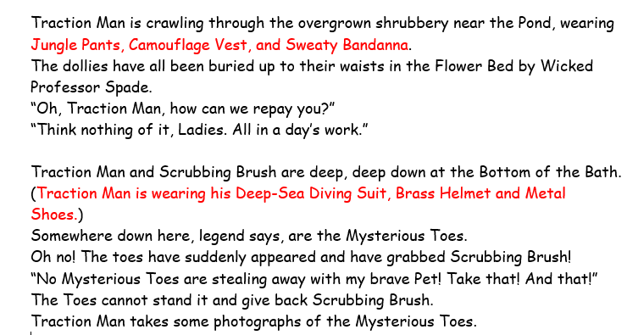
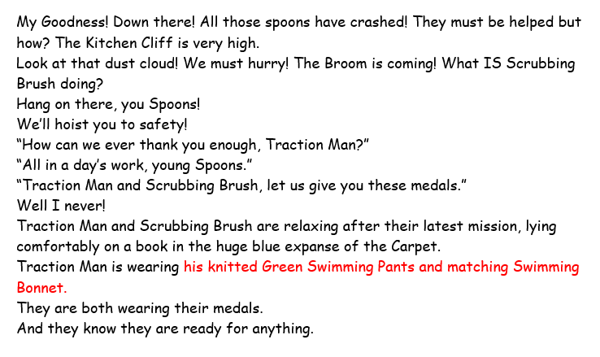
3
1
2
4

Slide 7
Wednesday’s Task
Each little scene in Traction Man follows a pattern.
It says where it is happening.
What Traction man is wearing.
What the problem is.
How traction man helps
What the rescued toys, objects say in thanks
Copy out this scene in P* handwriting into your workbook.
Traction man is in the bedroom. He is wearing his latex space suit and perspex helmet. He is heading towards the evil pillows who are holding the farm animals captive. He jumps on the pillows wearing his rocket boots and saves them. The farm animals are very happy and say “hooray for traction man!”
Choose one more scene and follow the structure to write out another scene. You don’t need to copy the
exact words of the book but try and write out a scene in the present tense as if it’s happening now.
Remember to use P* handwriting.

Slide 8
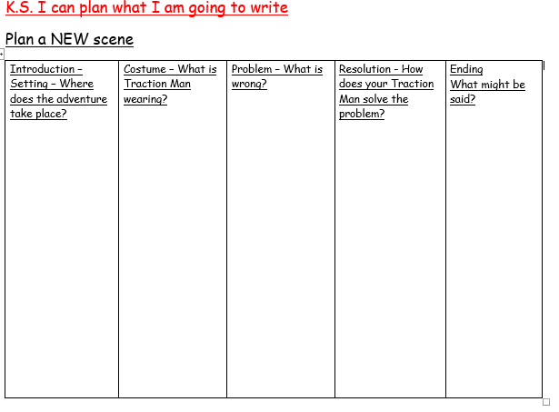
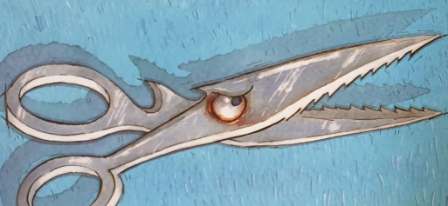
Thursday’s Task
Plan a new scene and mini adventure for Traction Man.
(If you are stuck for ideas you could look at the
last page where I can see a pair of evil scissors in the picture……)

Slide 9
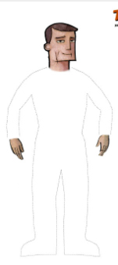
Friday’s Task
Use your plan to write a new scene in your workbook.
Today I would like you to write out your new scene (mini adventure) for Traction Man. Follow the structure of a scene like you practised on Wednesday.
You must use the present tense – imagine you are playing with Traction man.
You might find it easier to use your plan from yesterday and then act it out before writing.
E.g. Traction man is racing quickly towards the evil scissors in a plastic cup, wearing his red and black formula one outfit.

