Slide 1
Coundon Primary School Year 2 Guided Reading Home Learning Week commencing 18.5.20

Slide 2
Activities included in this PowerPoint
FIRST AND FOREMOST, PLEASE LISTEN TO YOUR CHILD READ EACH DAY – this can be their reading book, magazines, comics, books from home, e-books or even sharing stories with yourselves.
Included in this PowerPoint are a selection of guided reading activities in the style that we would usually use in school. There are enough activities for 1 week of learning. All activities can be completed in your child’s exercise book. Activities are set at the Age Related Standard for Year 2. Some children will be able to complete these activities independently; some children will need adult support. If your child did not pass the Phonics Screening Test at the end of Year 1 or finds any of these activities particularly challenging, please use the phonics power point provided instead. This concentrates on the mastery of blending and segmenting skills needed to decode unfamiliar words.
Each activity on this power point is based on some of the following reading skills:
Vocabulary: Draw upon knowledge of vocabulary in order to understand the text
Infer: Make inferences from the text / explain and justify inferences with evidence from the text
Predict: Predict what might happen based on what you have read
Explain: Explain your preferences, thoughts and opinions about the text
Retrieve: Identify and explain the key features of fiction and non-fiction texts such as characters, events, titles and information
Sequence: Sequence the main events of a story

Slide 3
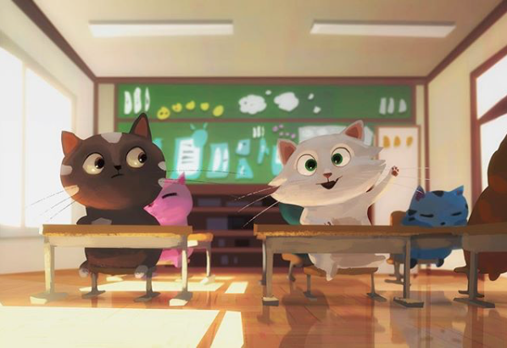
Day One: Cat School
Discuss the following questions:
Where do you think this is? How do you know?
How many cats are in this class?
What time of day is it? Why do you think that?
Why is the white cat putting its paw up?
What are the other cats doing/thinking?
How is the black cat feeling? Why?
In your book draw OR describe what you think their teacher looks like.

Slide 4
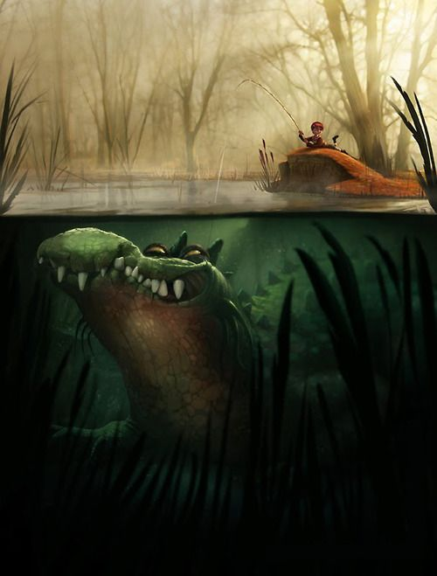
Day Two: Crocodile
Discuss the following questions:
Describe the scene. How does the picture make you feel?
Do you think the boy knows what lurks beneath the surface?
What do you think he can see/hear?
What is the crocodile’s character like?
In your book predict what you think might happen next
Don’t forget to include a feeling sentence- how does the boy feel?
Don’t forget to include adjectives or expanded noun phrases.

Slide 5
Day 3 Crocodile (non fiction)Comprehension Answer the following questions in your books

Slide 6
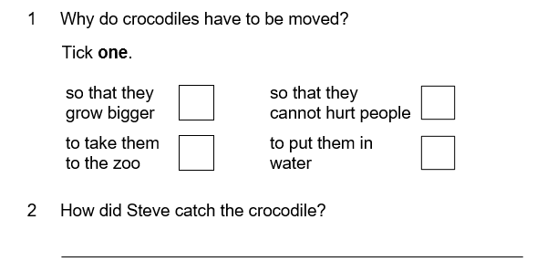

Slide 7
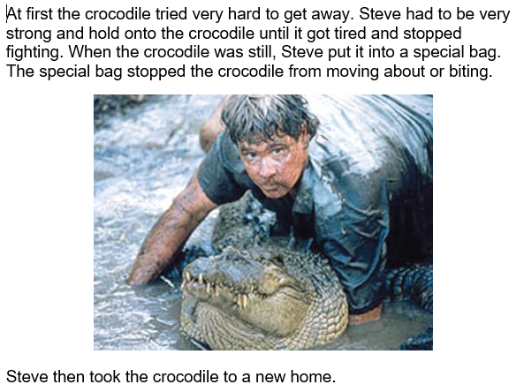
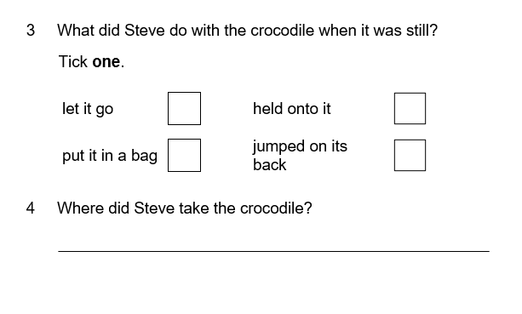

Slide 8
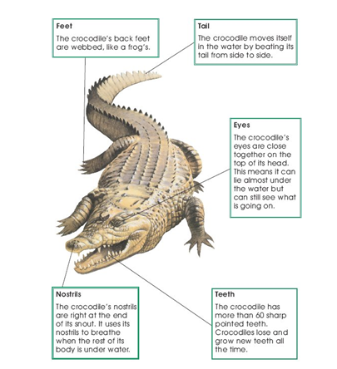
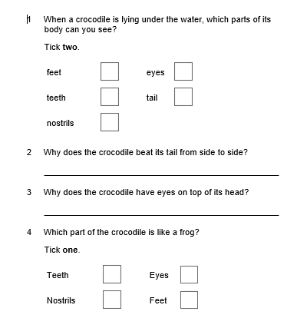
Day 4 : Meet the Crocodile

Slide 9
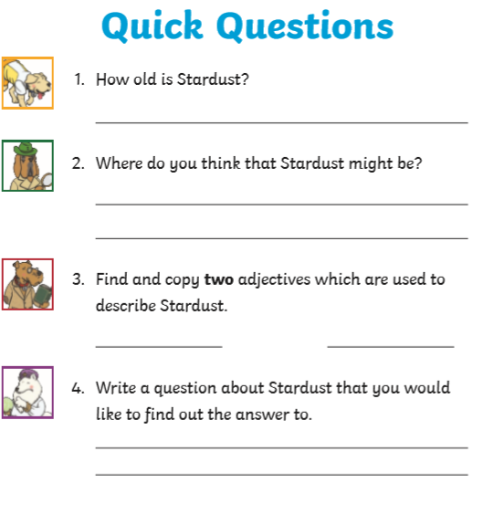
Day 5 – Fiction Comprehension

