Slide 1
Year 2 Mathematics week 1 beginning 27/4/20
Let’s practise addition!

Slide 2
Day 1 Reminder Addition of two 2 digit numbers
Do you remember?
We can add by partitioning into tens and ones
53 + 24 = 77
50 + 20 = 70
3 + 4 = 7
70 + 7 = 77
Let us practise this today

Slide 3
Dear Parents, The children have learnt how to add with different methods.
Sometimes they may choose to draw dienes to help them.
They might prefer to partition into tens and ones which we have also practised.
The next method is column addition which is the quickest method of adding larger numbers. We always start by the EXPANDED METHOD of addition so children understand what they are doing with tens and ones and this is the new learning for this week.
Next week we will look at the traditional concise method of column addition.. If your child is struggling it is ok to HELP and SHOW them how to do each calculation. It is also acceptable for them just to continue to draw dienes or partition to add. Any method is ok if they can easily get the correct answer!
Work can be done in exercise books BUT if you can print off squared paper this would be best! (and stick in if time!)
http://www.mathsphere.co.uk/downloads/graph-paper/graph-paper-1cm-squares-blue.pdf

Slide 4
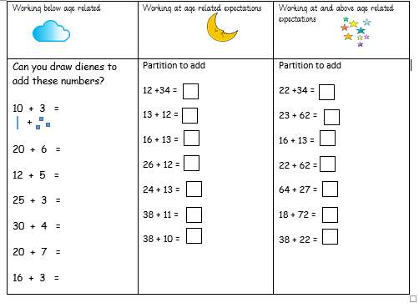
Day 1 Task Addition by partitioning into tens and ones Choose clouds, moons or stars and copy into your exercise books – if you want to print 1 cm squared paper to help with layout this will be even better and then stick into your exercise book. http://www.mathsphere.co.uk/downloads/graph-paper/graph-paper-1cm-squares-blue.pdf

Slide 5
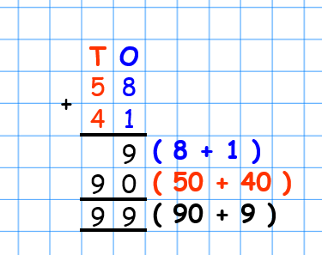
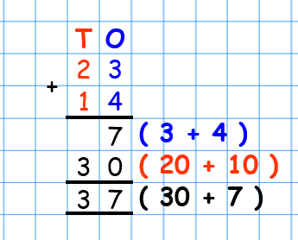
Day 2 Expanded Column Method Addition of two 2 digit numbers
There is another way we can add two numbers – we can use the column method of adding. Today we are using the expanded method of addition.
Add the ones first and then add the tens.
If you want to try this method of adding (moons and stars) copy these examples into your book. It is best to use squared paper so that you stay in your columns!
http://www.mathsphere.co.uk/downloads/graph-paper/graph-paper-1cm-squares-blue.pdf

Slide 6
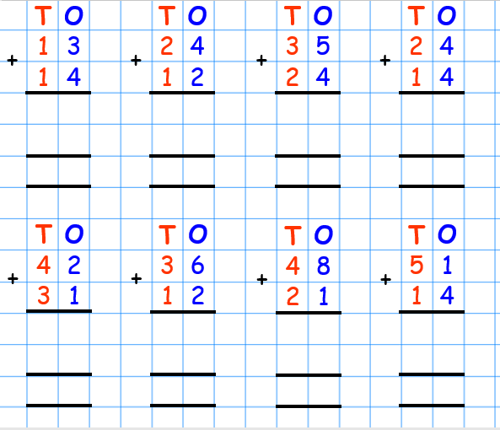
Day 2 - Task
Clouds – draw dienes 20 + 13 = 33 || + |… 12 + 18 = 20 + 12 = 13 + 10 = 20 + 15 = 11 + 12 = 15 + 10 =
Moons and Stars – Have a go at these!

Slide 7
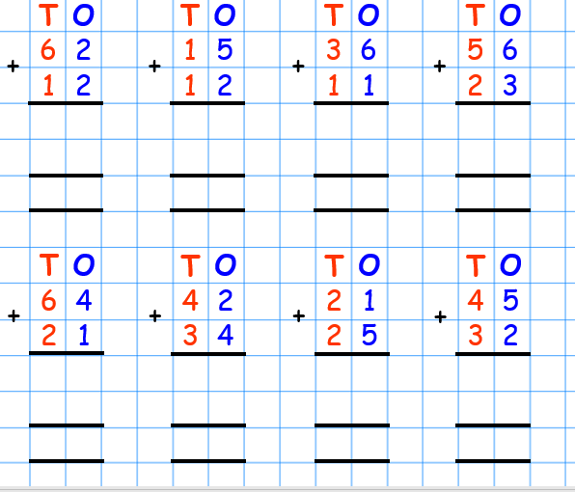
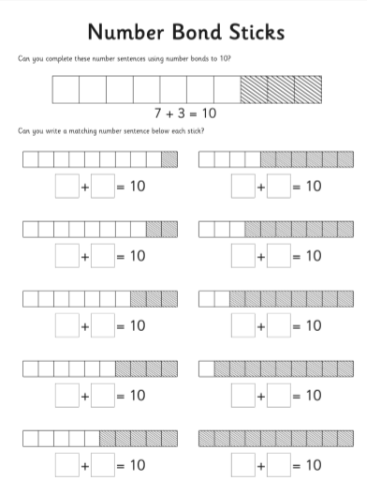
Day 3 - Task
Clouds Copy the number sentences into your book and fill in the missing numbers by looking at the stick pictures. eg 7 + 3 - 10
Moons and Stars – Have another go at these!

Slide 8
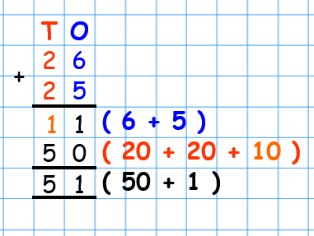
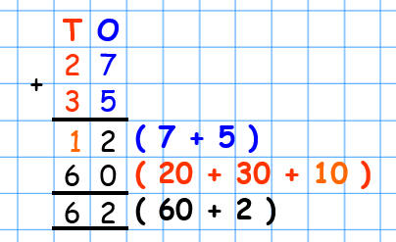
Day 4
Expanded Column addition of 2 digit numbers crossing tens
Are you adding even bigger numbers? What happens if your ones come to more than 10?
Have a look at this!
The ones add up to more than 10 (they make 11) Make sure you put your numbers in the correct
column and remember to add up all the tens at the end. Copy this into your book.
Use squared paper to help you.
http://www.mathsphere.co.uk/downloads/graph-paper/graph-paper-1cm-squares-blue.pdf
Now copy out this example too. Do you understand what is happening with our tens and ones?

Slide 9
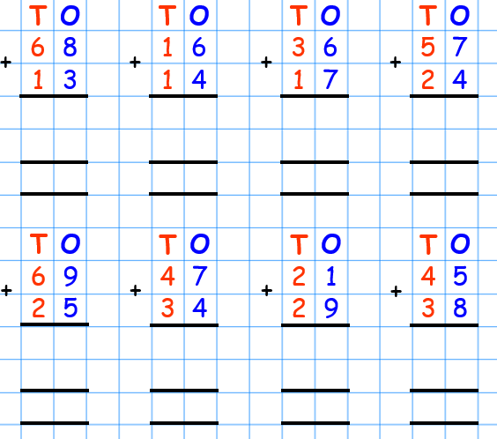
Day 4-Task
Clouds Write the switchers Copy each pair into your book! 4 + 6 = 10 6 + 4 = 10 3+7 = 10 7+___ = 10 9 + 1 = 10 1 + ___ = 10 2 + 8 = 10 8 + ___ = 10 5 + 5 = 10 5 + __ = 10
Moons and Stars – Use the examples above to try these out. Ask a grown up to help you!

Slide 10
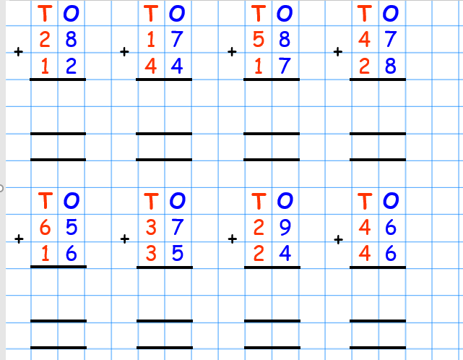
Day 5-Task
Clouds Write the switchers Copy each pair into your book! 14 + 6 = 20 6 + 14 = 20 13 + 7 =20 7+___ = 20 19 + 1 = 20 1 + ___ = 20 12 + 8 = 20 8 + ___ = 20 15 + 5 = 20 5 + __ = 20 | Moons and Stars – Use the examples above to try these out. Moons and Stars – Use the examples above to try these out. Ask a grown up to help you! Ask a grown up to help you!
Moons and Stars – Have another go at these! Ask a grown up to check your work!

