Slide 1
Year 2 Mathematics week 1 beginning 4/5/20
Let’s practise addition!

Slide 2
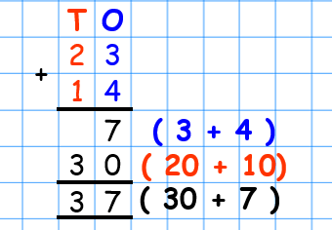
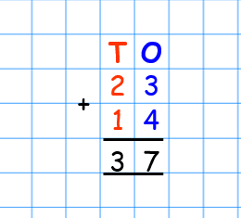
Day 1
REMEMBER Last week we did expanded columnar addition! This week we are going to make this easier! Now we know what we are doing when we add the ones and then tens we can use the concise method of column addition. Today we will not do any regrouping! (no carrying of tens) This will make it easier to get started!
This is the
quickest method of
column addition!
Write the numbers underneath each other and line up the tens and ones.
Add the ones FIRST
Add the tens

Slide 3
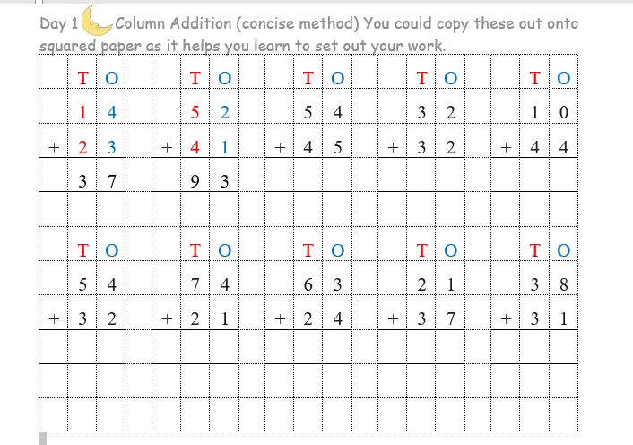
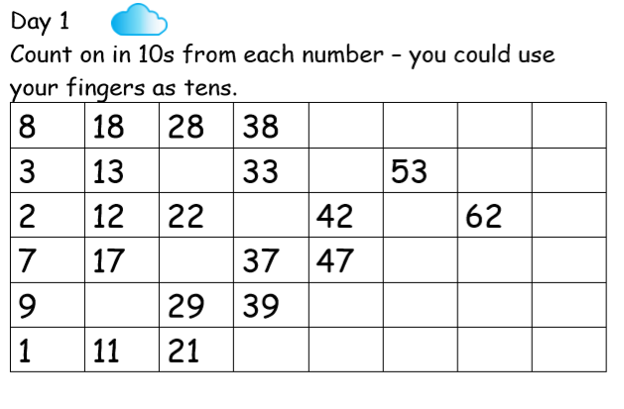
Day 1 Task Addition Choose clouds or moons and copy into your exercise books – if you want to print 1 cm squared paper to help with layout this will be even better and then stick into your exercise book. (If you find it easier you can print the sheet off that is attached on the blog) http://www.mathsphere.co.uk/downloads/graph-paper/graph-paper-1cm-squares-blue.pdf
Clouds Task | Moons/Stars Do this task
Clouds Task Moon/Star task

Slide 4
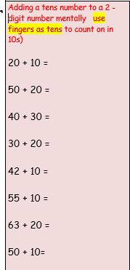
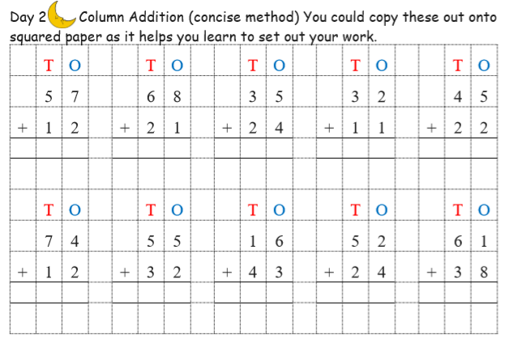
Day 2 Task-Let’s continue to practise!
Choose clouds or moons and copy into your exercise books – if you want to print 1 cm squared paper to help with layout this will be even better and then stick into your exercise book. (If you find it easier you can print the sheet off that is attached on the blog)
Clouds Task | Moons/Stars Do this task

Slide 5
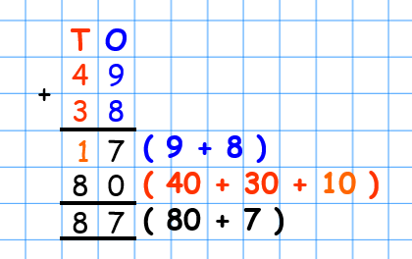
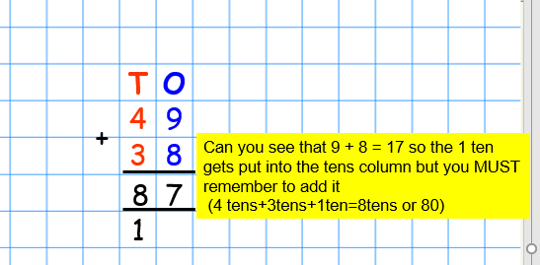
Day 3
Let’s learn how to regroup! (carry a tens number)
This is where it can get tricky…….you have to remember that there is going to be an extra number in the tens column that needs to be added!
This is how we did it last week when we did expanded addition BUT what do you do in the concise method when the ones column adds up to more than 10?

Slide 6
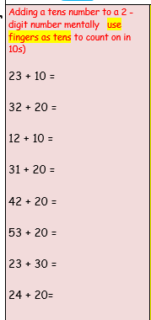
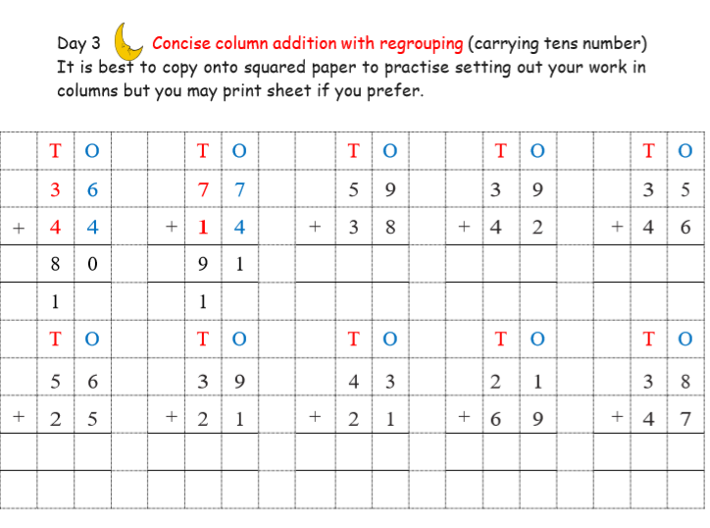
Day 3 Task
Moons - Let’s have a go at column addition with regrouping – carrying the tens. Make sure that
you put each number in the correct column. It helps to label the columns
Tens (T) and Ones (O) Again copy onto squared paper OR print off the sheet.
Clouds Task | Moons/Stars Do this task

Slide 7
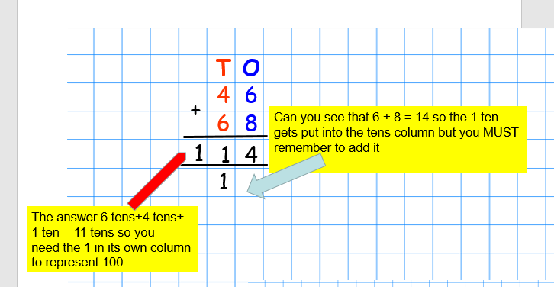
Day 4 – teaching for extra stars challenge…….
How did you get on with column addition yesterday? Shall we practise a few more? I might give you some stars challenges where the answer is over 100 so make sure you set out your work really carefully! The hundreds number
should have it’s own square – don’t squash the answer into two boxes!

Slide 8
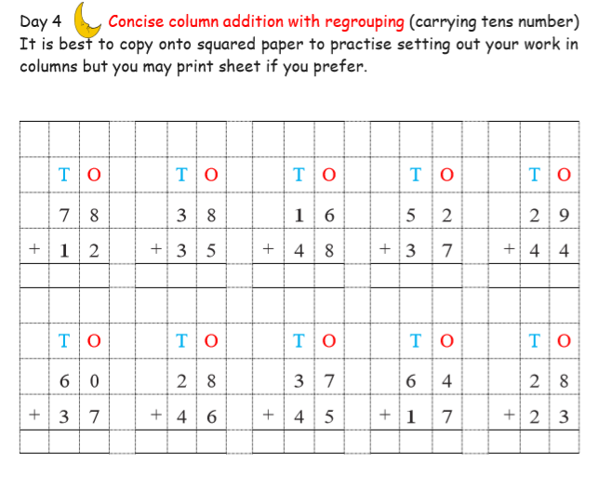
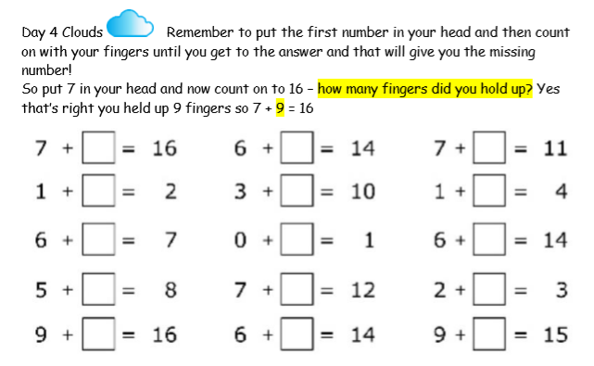
Day 4 Tasks
Choose the activity that you think you can do. Again it is best to practise copying out your work onto squared paper
keeping your numbers in the correct columns but if you prefer you can print off the sheets.
Clouds | Moons | Stars

Slide 9
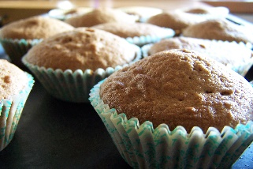
Day 5 TASK
It’s Friday! Let us do something different!
Ask your grown up if you can do some weighing and baking. Choose one of these……
KRISPIE CAKES Weighing is the measuring of weight Weigh these ingredients in grams….. 125g chocolate 60g rice krispies 60g mini marshmallows Sprinkles Paper cake cases Make yummy chocolate krispie cakes OR choose another recipe and send a photo to us of your creation! | FAIRY CAKES Weighing is the measuring of weight Weigh these ingredients in grams….. 100g butter or margarine 100g sugar 2 eggs 100 self raising flour Mix the ingredients – it’s easiest to mix all together but you can mix the butter and sugar first and then add the eggs and flour. Put in small cakes cases Cook in a pre-heated oven gas mark 5 or 190 ̊c CHOOSE how to decorate them and send us a picture!

