Slide 1
Year 2 Mathematics week 3 beginning 11/5/20
Let’s practise subtraction

Slide 2
Day 1- quick reminder
REMEMBER Today let’s practise drawing dienes to subtract (no regrouping/crossing tens)
We have practised many methods for subtraction but today let’s just go back to drawing dienes to help us subtract.
So 33-11 = 21
In this method we just draw the biggest number and then cross out the tens and ones eg 11 = 1 ten and 1 one so we cross it out.

Slide 3
Day 1 Task –copy onto squared paper or books but please show working out.
Clouds Task – Subtract two digit numbers and ones 23 – 2= 21 ll▪▪▪ 16 – 3= 27-6= 42-1= 25-4= 65-2= 29-9= 35-2= 28-8= 49–5= | MoonsTask – Subtract a two digit number from a two digit number 43 – 12= 31 llll▪▪▪ 36 – 23= 57-16= 92-31= 85-40= 65-52= 99-29= 65-32= 28-18= 39–25=

Slide 4
Day 2- quick reminder
REMEMBER – we can subtract by drawing a blank numberline. If you have
a ruler this will help you. Label CAREFULLY with SMALL DIGITS
56 – 3 = 53
________________________________________
53 54 55 56
If the number is larger partition the second number into tens and ones
and do hops of tens and ones
45 – 12 = 33
-1 -1 -10
_____________________________________
33 34 35 45
OR you can just hop back 10 and 2
-2 -10
____________________________________________
33 35 45

Slide 5
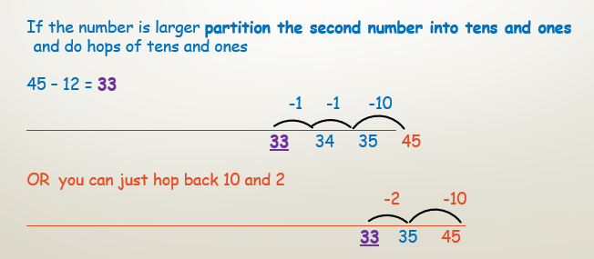
Day 2 Task - Choose 1 task -copy onto blank numberline paper or draw lines
onto squared paper or books but please show working out.
Clouds Task – Subtract two digit numbers and ones 56–3=53 16–2= 17-6= 22-1= 35-4= 25-2= 59-9= 25-2= | MoonsTask – Subtract a two digit number from a two digit number 45-12=33 52-21= 65-20= 63-12= 94-22= 35-22= 38-13= 69–22=

Slide 6
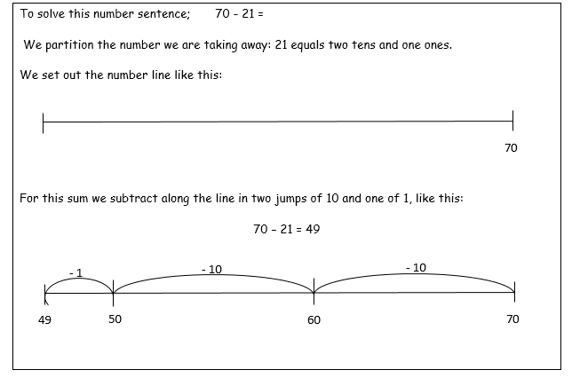
Day 3- quick reminder
Sometimes the number will cross another tens and so you need to be extra careful
counting backwards

Slide 7
Day 3 Task - Choose 1 task -copy onto blank numberline paper or draw lines
onto squared paper or books but please show working out.
Clouds Task – Subtract two digit numbers and ones (like yesterday!) 46–2= 57-6= 32-1= 25-2= 65-3= 79-4= 25-3= 17-4= | Moons Task – Subtract a two digit number from a two digit number (crossing tens) 70-21=49 22-11= 32-23= 31-12= 34-25= 23-14= 82-13= 90–12=

Slide 8
Day 4 – another method of subtraction
reminder (stars)
You need to partition the second number into
Tens and Ones to take away from the largest number.
SHOW ALL OF YOUR WORKING OUT
46-32 = 14
46 – 30 = 16
16 – 2 = 14

Slide 9
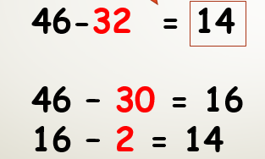
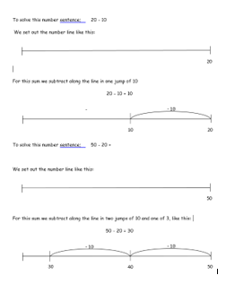
Day 4 Task – Choose 1 task -copy onto blank numberline paper or draw lines
onto squared paper or books but please show working out.
Clouds – subtracting tens from a two digit number using numberline Copy these examples 20 – 10 = 10 50 – 20 = 30 50 – 20 = 60 – 20 = 35 – 10 = | Moons Continue with a blank numberline (draw or download sheet) - hops of tens and ones 26 – 23= 47 – 31= 92 – 11= 46 – 22= 54 – 14= 36 – 22= 35 – 33= | Stars Copy this example and then do these the same way… 56 – 23= 67 – 45= 82 – 21= 96 – 54= 84 – 32= 76 – 52= 65 – 33=

Slide 10
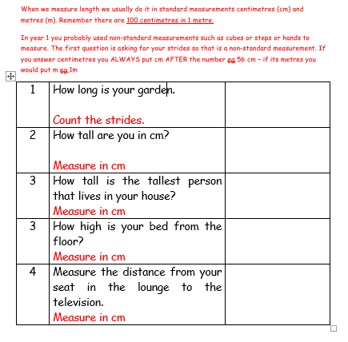
Friday – Measuring Time! Find a tape measure……if you can!

