Slide 1
Year 2 Mathematics week 4 beginning 18/5/20
Let’s measure!

Slide 2
Did you do some baking and weigh the ingredients a couple of weeks ago?
Did you measure some heights and lengths last week?
Are you practising telling the time? (measuring of time)
All of these things are MEASUREMENT
activities.
This week we are just focussing on weight
and capacity.
ALSO…. Each day we are revising our times
tables too with a starter activity….

Slide 3
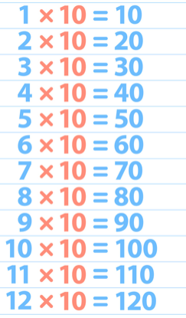
Day 1 Starter
Remember the 10 x table?
Oops – Practise it quickly…Chant it! Sing it! March to it!
OR find the 10 x song and sing along!
https://www.youtube.com/watch?v=8yxMJUHBslY

Slide 4
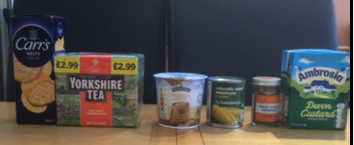
Day 1 Tasks….
We are measuring in grams.
There are 1000g (grams) in 1 kg (kilogram) If you want to click on the link below you will find a song about weight and capacity.
https://www.bbc.co.uk/teach/supermovers/ks1-maths-capacity-volume/zj8njhv
Learn to estimate how heavy an object might be.
Look at these objects from the kitchen cupboard.
Task 1 – Estimate (a good guess!) the order these might go in from heaviest to lightest. Write your estimate in your exercise book.

Slide 5
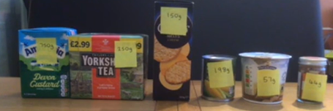
Day 1 Tasks continued….
I have put the weights on in grams and put them in order.
Was your estimate correct?
Find 5 items in your kitchen cupboard. Look at the weight in grams. Can you put them in order and write or draw them in your book from heaviest to lightest (OR take a photograph and stick it in your book.) Remember if an item is 1kg (1 kilogram this means 1000g (1000 grams) Can you now put them in order from the lightest to heaviest?
If you have the internet you could now play this game
https://www.topmarks.co.uk/ordering-and-sequencing/coconut-ordering

Slide 6
Day 2 Starter
Practise the 10 x table?
Click the link below and choose 10x table
https://www.topmarks.co.uk/maths-games/hit-the-button
OR Times Table Rockstars OR quickly answer this quiz
3 X 10 = 10 x 7 =
9 x 10 = 10 x 4 =
4 x 10 = 10 x 2 =
2 x 10 = 10 x 6 =
8 x 10 = 10 x 12=
12 x 10 = 10 x 11=

Slide 7
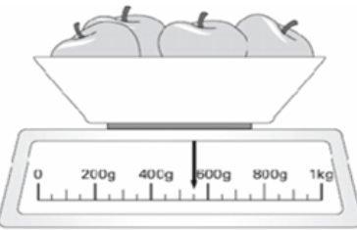
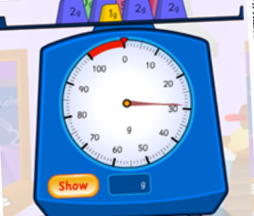
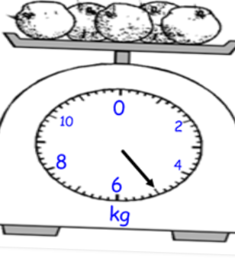
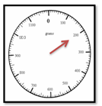
DAY 2 continued…….
Today you will be learning to read a scale in grams or kilograms. We use a scale to weigh objects to see how heavy they are. Look at the scales below and see if you can read them.
Weight is measured in grams (g) and kilograms (kg)
Can you read the scales below?
Not all scales go round - some go up and down, some are digital and some go across like the one in the picture. This is tricky to work out. The number before on the scale is 400g. The number after is 600g. Can you work out the weight from the scale? The marks on the scale go up in jumps of 50g. The weight is 550g.
This time the scale is different. Can you see what it goes up in this time? The numbers go up by 10g each time. Where is the arrow pointing? It is just before the 30g mark. This means that the weight is 29g.
This scale is measuring in kilograms (kg). There is no number where the arrow is pointing but can you work out what the number would be? It is half way between the 4kg and the 6kg mark. The weight is 5kg.
The scale is measuring weight in grams. The numbers around the scale go up in 100s. The arrow points to the weight of the object. Can you work out what it is? The weight is 200g.

Slide 8
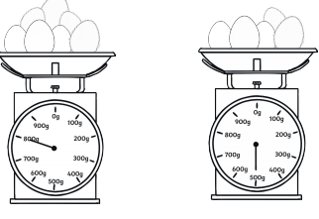
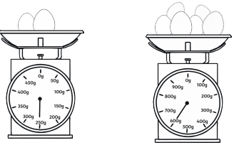
DAY 2 clouds TASK
Read the scales and answer in your exercise book.
1
2
3
4

Slide 9
DAY 2 MOON TASK Read the scales and write the answers in your exercise book.
1
2
3
_______
________
________
4
5
6
_______
_______
_______

Slide 10
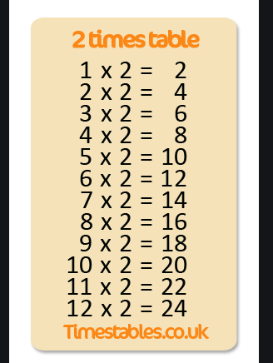
Day 3 Starter
Remember the 2 x table?
Oops – Practise it quickly…Chant it! Sing it! March to it!
OR find the 2 x song and sing along!
https://www.youtube.com/watch?v=BGWMPqh04o4

Slide 11
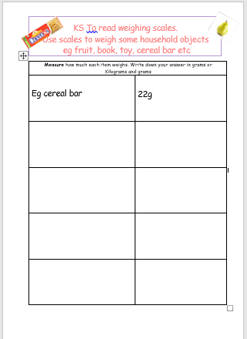
DAY 3 TASK
Write the item and how much it weighs into your exercise book.

Slide 12
Day 4 Starter
Practise the 2 x table?
Click the link below and choose 10x table
https://www.topmarks.co.uk/maths-games/hit-the-button
OR Times Table Rockstars OR quickly answer this quiz
3 X 2 = 2 x 7 =
9 x 2 = 2 x 4 =
4 x 2 = 2 x 2 =
2 x 2 = 2 x 6 =
8 x 2 = 2 x 12 =
12 x 2 = 2x 11 =

Slide 13
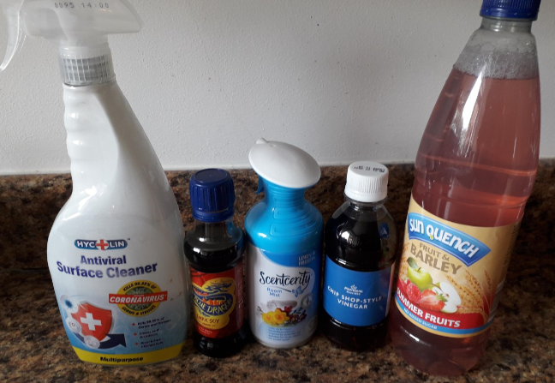
Day 4 Tasks…
We are measuring capacity in millilitres (ml) and litres (l)
There are 1000ml (millilitres) in 1 l (litre) Here is that song again…….
https://www.bbc.co.uk/teach/supermovers/ks1-maths-capacity-volume/zj8njhv
Can you estimate the order these might go in
from the largest capacity to the smallest capacity.
Write the answers in your book.
Now check the next slide
Capacity is measured in millilitres (ml) and litres (l)
There are 1000ml in 1l
When we measure capacity we use containers that have a scale marked in litres or millilitres.

Slide 14
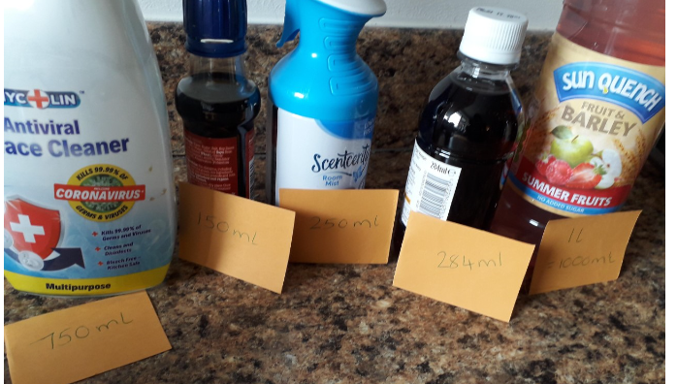
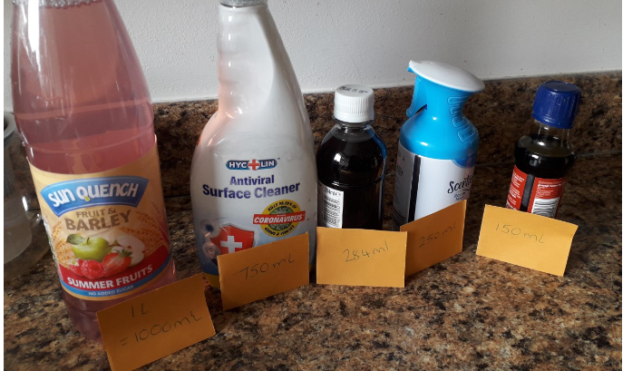
DAY 4 TASK continued……
This photo shows the capacity of each container.
It is much easier now to put into the correct order!
Find 5 items with liquid in that have a measurement in ml or l and write them in your book
From the most to the least
And now from least to the most

Slide 15
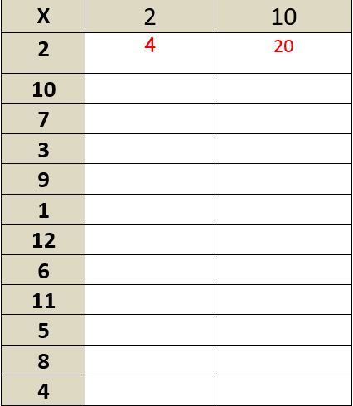
Day 5 Starter
Play on times table rockstars OR complete this grid OR write out your 2x and 10x table from memory
in your books.

Slide 16
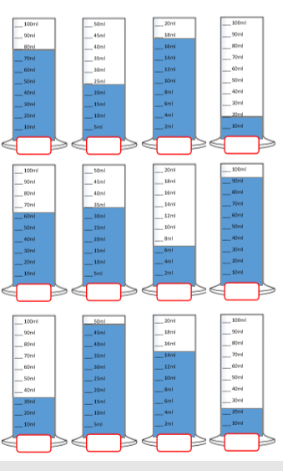
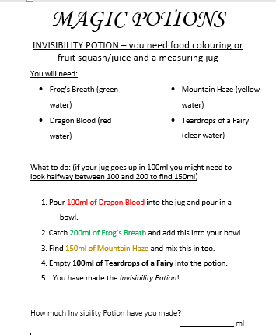
Day 5 Tasks…
We are measuring capacity in millilitres (ml) and litres (l)
CHOOSE ONE ACTIVITY
If you have a measuring jug ask a grown up if
you can measure some liquid
Or read these
scales and write
the answers in ml

