Slide 1
Year 2 Mathematics week 5 beginning 1/6/20
Measurement Part 2

Slide 2
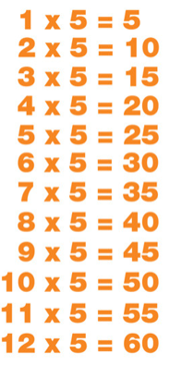
Day 1 Starter
Remember the 5 x table ?
Chant it! Sing it! March to it!
You could sing along to the YouTube 5x table song
https://www.youtube.com/watch?v=gfRVYPcfecE

Slide 3
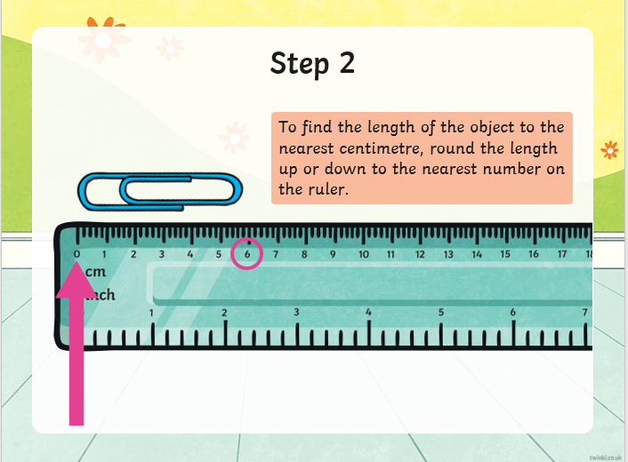
How to use a ruler
There are 10 millimetres (10 mm) in 1 centimetre
(1cm)
There are 100cm in 1 metre (1m)

Slide 4
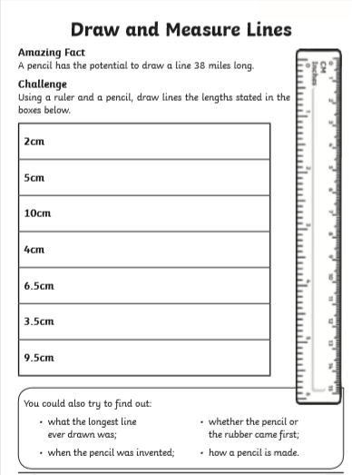
Day 1 Task
Let’s practise using a ruler.
Make sure you use centimetres cm on
your ruler when you draw the lines.
(NOT inches)
Extra Challenge! (IF you have a printer)
You could also print off this measuring sheet by clicking here and
measure the printed lines with a ruler.

Slide 5
Day 2 Starter
Practise the 5 x table
Click the link below and choose 5x table
https://www.topmarks.co.uk/maths-games/hit-the-button
OR answer the quick quiz below
3 x 5 = 5 x 7 =
9 x 5 = 5 x 4 =
4 x 5 = 5 x 2 =
2 x 5 = 5 x 6 =
8 x 5 = 5 x 12=
12x 5 = 5 x 11=

Slide 6
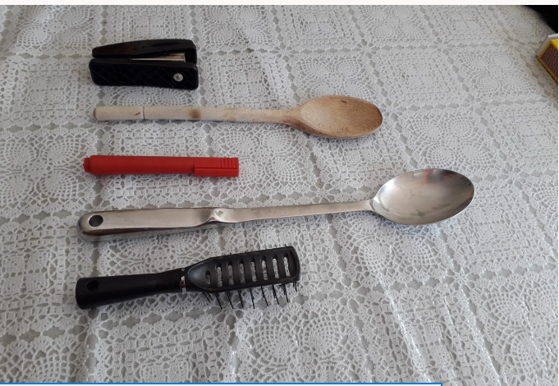
Day 2 Tasks
Longer than, shorter than….
Can you find and measure the length of some household objects eg hairbrush, toothbrush, spoon etc
Put them in order from the longest to the shortest.
Look below at these objects . How would you order them from longest to shortest? (answers on next slide)

Slide 7
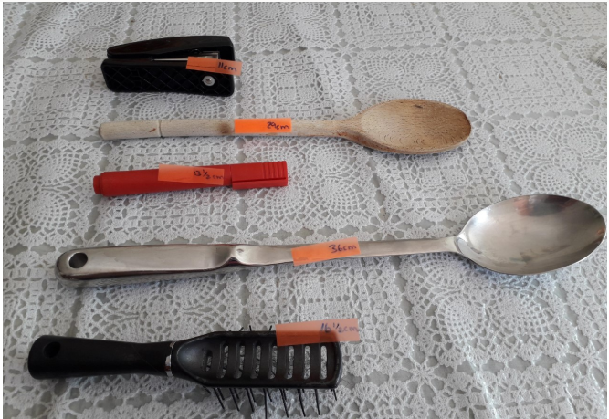
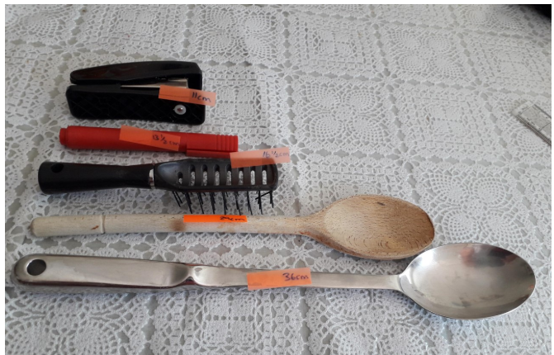
Day 2 Tasks continued……
When you have measured items it
is easier to put them in order!
TASK 1
Using longer and shorter complete these sentences in your book!
The wooden spoon is _____ than the brush.
The stapler is _________ than the pen.
The brush is _______ than the spoons but ________ than the pen.
The metal spoon is the longest.
The stapler is the shortest.

Slide 8
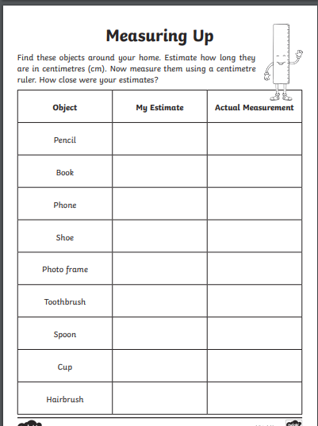
Day 2 Tasks continued……

Slide 9
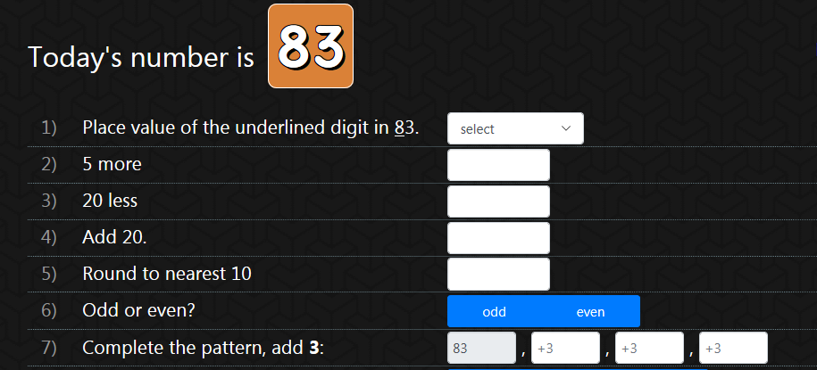
Day 3 Starter
Have a go at this NUMBER OF THE DAY ACTIVITY in your exercise book!

Slide 10
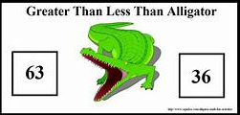
DAY 3 TASKS Do you remember using these symbols?
< = >
We can use these to compare weight
and length too.
> - greater than
< - less than
= - equal to
(THINK CROCODILE
the largest end is next to the largest
number or weight or length)

Slide 11
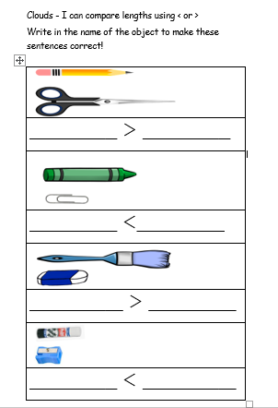
DAY 3 Clouds sheet
Copy sentences into your books

Slide 12
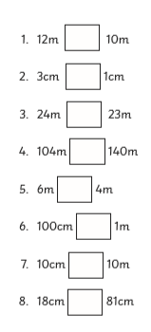
DAY 3 TASK Moons – copy and answer in your book using < = >
Just remember that 1m (metre) = 100cm (centimetres)

Slide 13
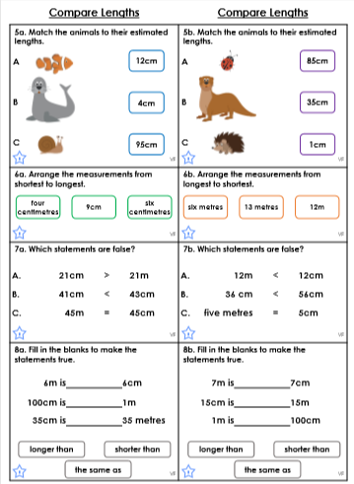
DAY 3 TASK Stars –Just remember that 1m (metre) = 100cm (centimetres)

Slide 14
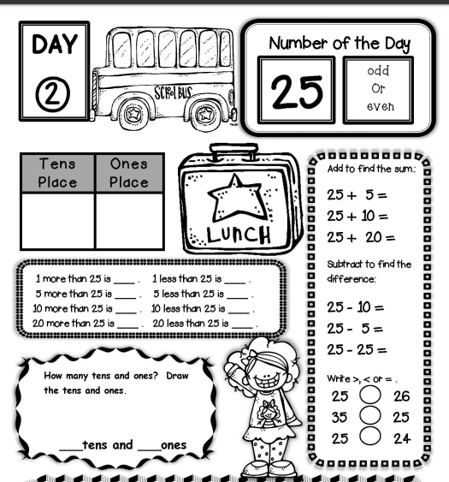
Day 4 Starter
Have a go at this NUMBER OF THE DAY ACTIVITY on the sheet or in your exercise book!

Slide 15
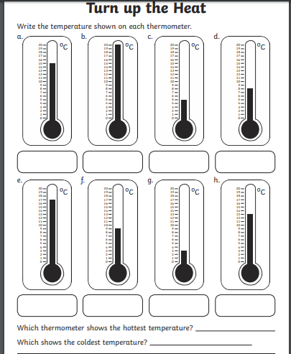
Day 4 Task
Temperature is measured on a thermometer
in degrees Celsius °C
Read the scales on these thermometers and write in your book or on the sheet

Slide 16
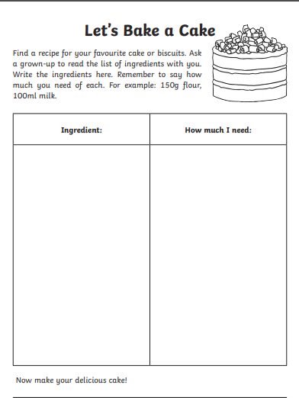
Day 5 Task
It’s Friday – let’s do some baking. If you haven’t got flour you could make anything! You could even weigh mud and stones and make a mud cake for fun (NOT TO EAT) or weigh birdseed and lard and make a bird cake.
Whilst it is baking answer these
questions on the next slide…..

Slide 17
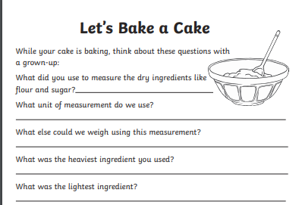
Day 5 Task continued..
Answer these questions
in your book or just
discuss the answers with
an adult.

