Slide 1
Year 2 Mathematics week 6 beginning 8/6/20
Money

Slide 2
Day 1 Starter- Think about these statements. You can write in your workbook or discuss with an adult!

Slide 3
Day 1 TASK
Do you remember?
How many 1ps in £1? (1 pound)
How many 10p in £1? (1 pound)
Look at these coin values.
Today please ask your grown up to find you some coins .
1) Sort the coins
2) Practise counting them – eg you could count a pile of 10ps in 10’s or a pile of 2ps in 2’s or 5ps in 5’s
3) Count a mixed pile 0f coins (it is easiest to count the largest coins first)

Slide 4
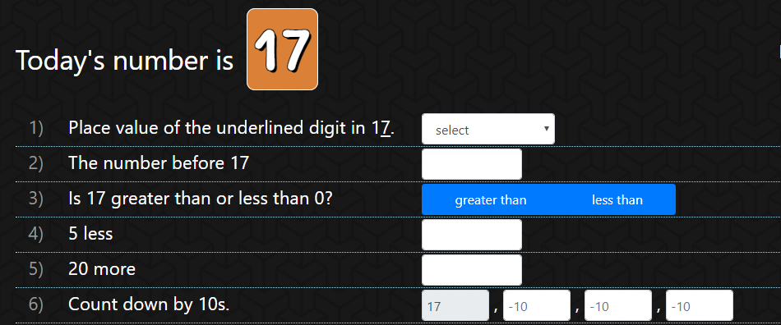
Day 2 Starter

Slide 6
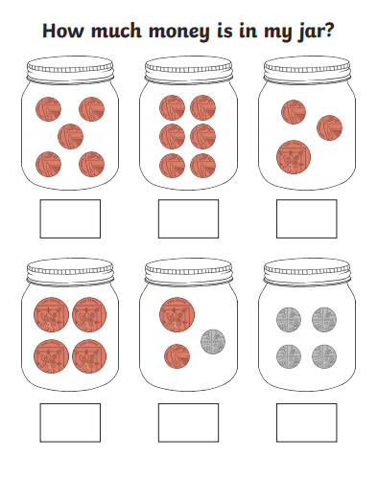
Day 2 Clouds
1
2
3
I have put the number on the jars so that you
can count the coins and write
the answers in your workbook if you haven’t a
printer for printing this slide.
4
5
6

Slide 7
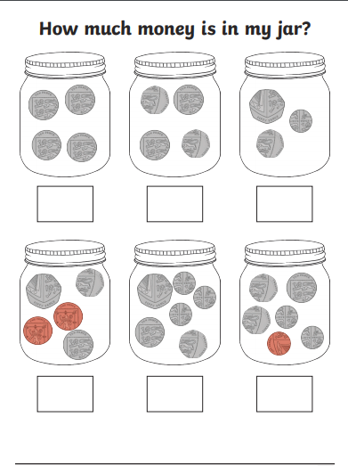
Day 2 Moons – Count the coins and
remember to put p for pence after
the amount eg 58p
1
2
3
I have put the number on the jars so that you
can count the coins and write
the answers in your workbook if you haven’t a
printer for printing this slide.
4
5
6

Slide 8
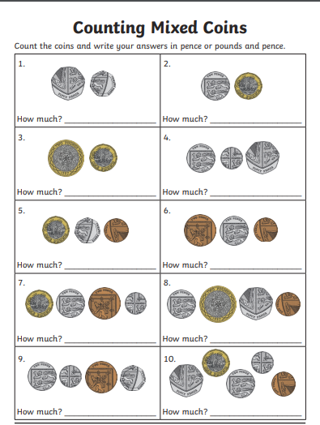
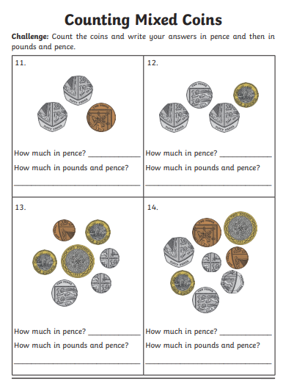
Day 2 Stars
Pupils record the pounds and pence separately using the symbols £ and p, for example £1 and 78p..
(they do NOT need to use decimal notation) You could write the answers in your workbook.

Slide 9
Day 3 Starter

Slide 10
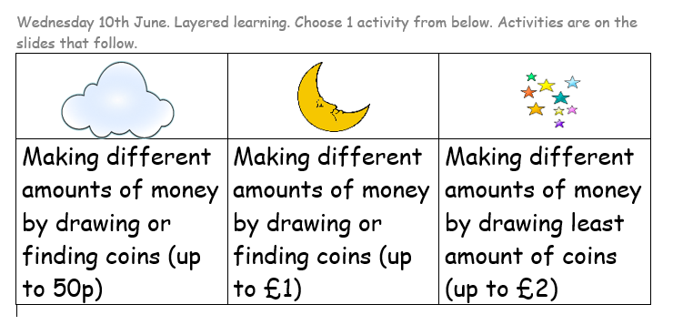

Slide 11
Day 3 Clouds
7p
12p
25p
30p
40p
16p

Slide 12
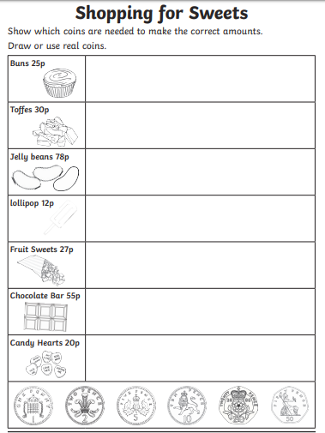
Day 3 Moons

Slide 13
Day 3 Stars
Draw the least amount of coins for…
58p
83p
£1 and 37p
£2 and 55p
£3 and 57p
95p
£4 and 95p

Slide 14
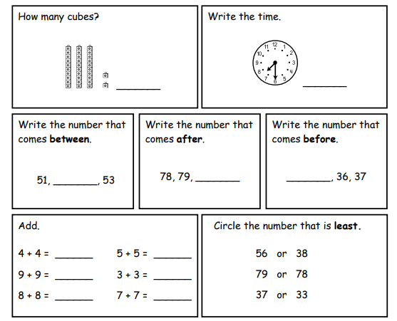
Day 4 Starter

Slide 16
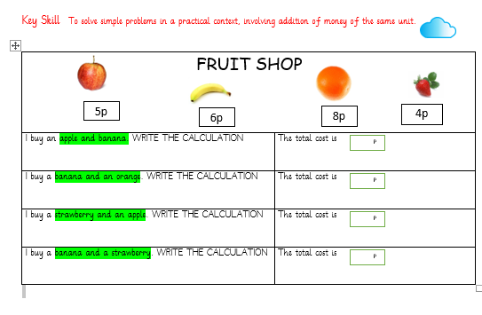
Day 4 Clouds

Slide 17
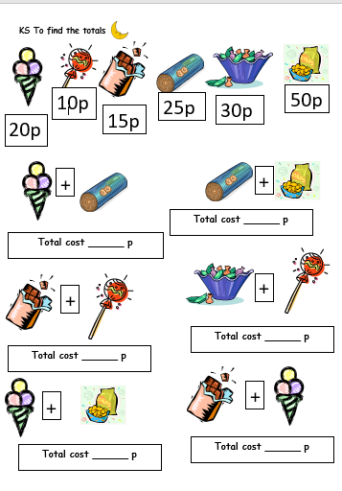
Day 4 Moons

Slide 18
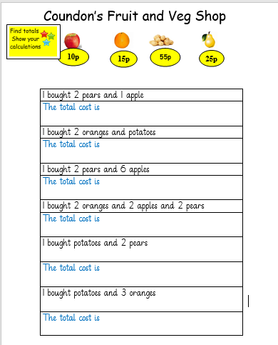
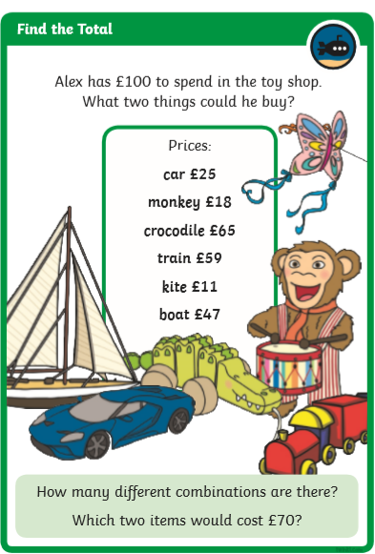
Challenge
Day 4 Stars

Slide 19
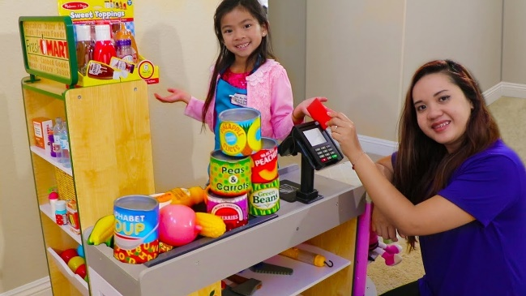
Day 5 Friday – the Fun Day
Starter – PLAY A GAME ON TIMES TABLE ROCKSTARS
Today ask a grown up or older brother or sister to
play shops with you!
Put prices on some items in your ‘shop’
Borrow some real coins
Buy items from the shop and pay with the correct coins
(if you have them) OR pay with more money and then
see if the shopkeeper can find the correct change.
You could swap and be the shopkeeper and then you might
have to work out the change!
Maybe you could send a photo to TEAMS or EMAIL your teacher of you playing shops!

