Slide 1
Year 2 Mathematics week 7 beginning 15/6/20
Geometry

Slide 2
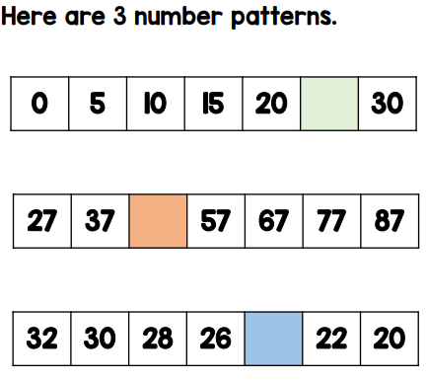
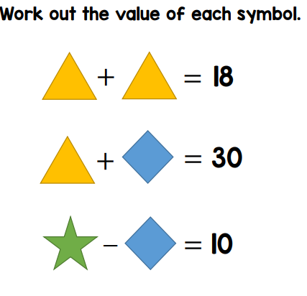
Day 1 Starter – Think, discuss and record in your book.
1. Fill in the missing numbers
Challenge
Can you find the total of these numbers by adding
together?
2. Remember a shape represents a digit so if you have 2 identical shapes they will be the same digit!

Slide 3
Dear Parents,
We are starting new learning on position and direction this week.
Most activities are the same for every child as all the children need to
learn the language of position, rotation and direction but if your child struggles you may wish
to do all the learning physically and with concrete objects.
Eg do a fun movement maths lesson using language such as….
Move 3 steps to the right
Go backwards 4 steps
Make a half turn clockwise
Make a quarter turn anti- clockwise etc
ALSO
You may need to use concrete resources to help with activity sheets
eg a pencil or cut out shape and physically rotate it – half turn, quarter turn etc

Slide 4
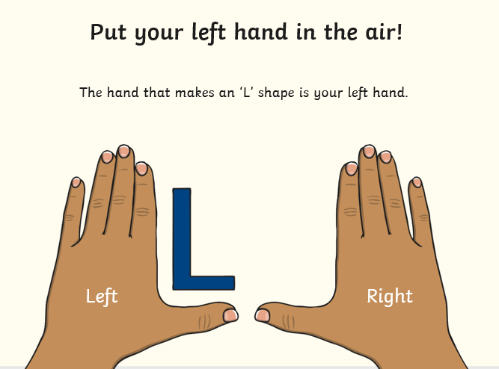
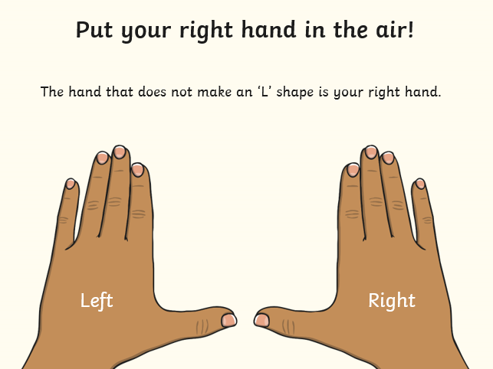

Slide 5
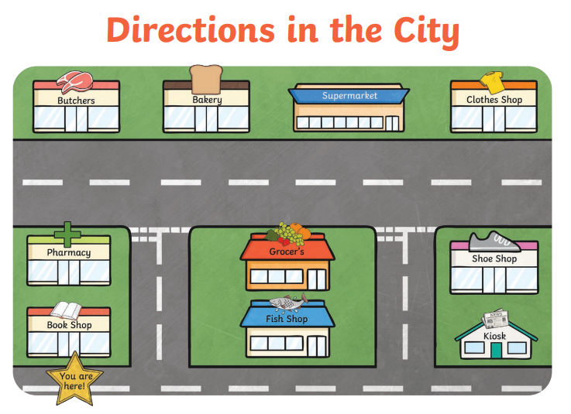
Day 1 TASK
Get a little figure eg playmobile person and take them on some journeys. Talk out loud and give directions.
Eg We are going to the butchers – go forwards, now turn left, keep walking forwards, now turn left again,there
it is on your right!

Slide 6
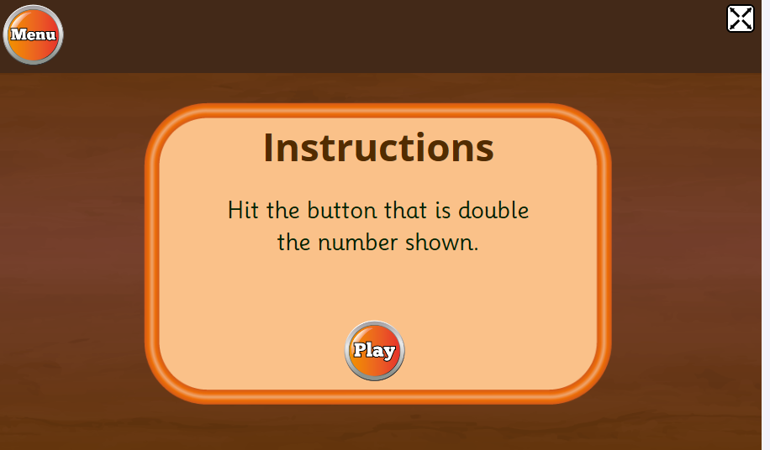
DAY 2 STARTER Play a game of DOUBLES – click here
https://www.topmarks.co.uk/maths-games/hit-the-button

Slide 7
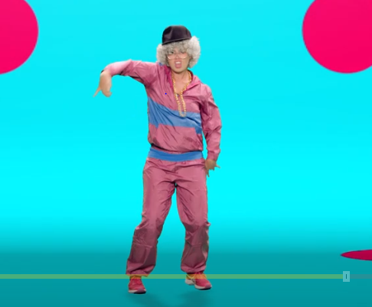
https://www.bbc.co.uk/sport/av/supermovers/42626760
Have a go at moves with supergranny!
This routine will teach you about position and direction. It covers important language like left and right, clockwise and anticlockwise.

Slide 8
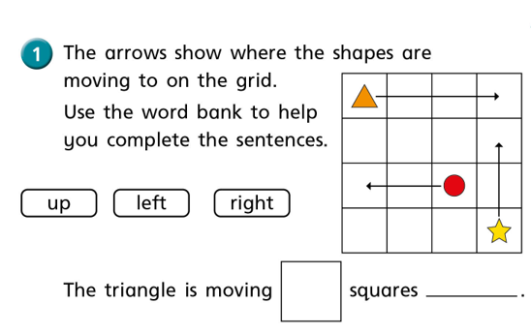
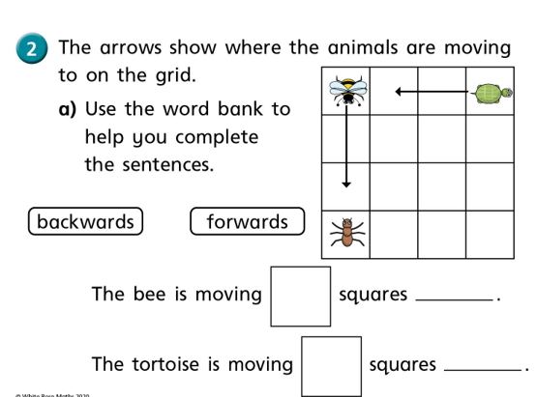
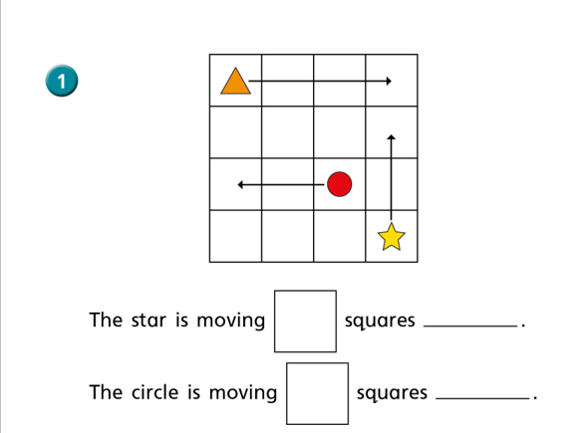
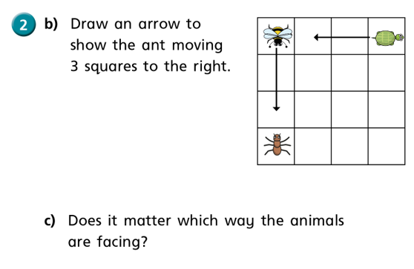
DAY 2 TASK The next 2 slides have today’s work on them. Discuss these 6 questions with an adult. Record the sentences in your book.
3
1
2
4

Slide 9
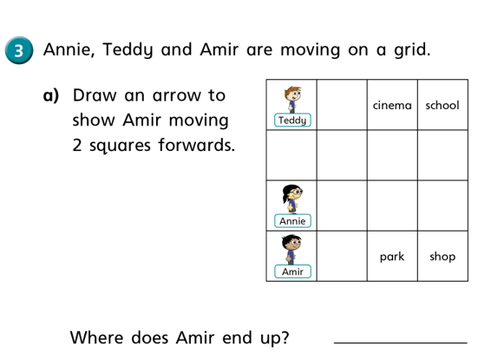
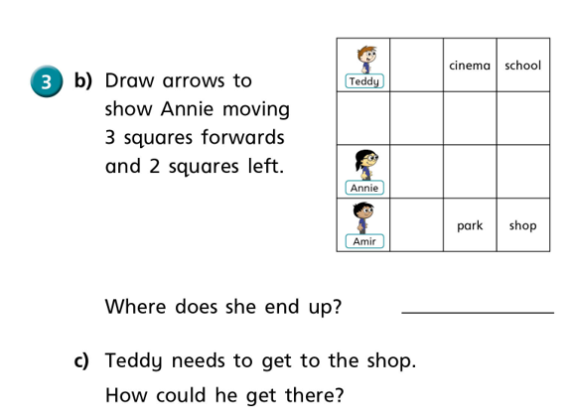
5
6
WELL DONE!

Slide 10
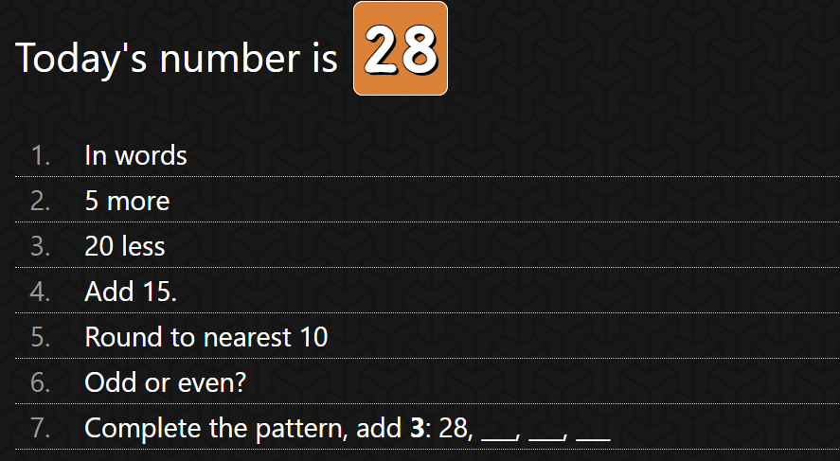
Day 3 Starter

Slide 11
DAY 3 Task – look at the following slides from
TWINKL to learn about these words
Clockwise
Anti-clockwise
Quarter turn
Half turns

Slide 12
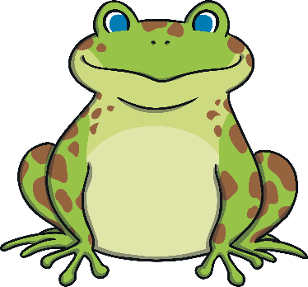
Making turns - clockwise
We call this one whole turn or a full turn.
If the frog turns to the right, it is turning clockwise.

Slide 13
Making turns – anti-clockwise
Anti means the opposite of.
If the rocket turns to the left, it is turning anti-clockwise.

Slide 14
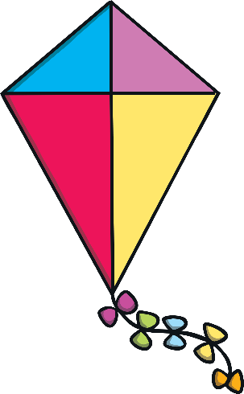
Making turns – a quarter turn clockwise
A quarter means there are 4
equal parts.
The kite might turn part of the whole turn.
The kite will turn a quarter of the whole turn clockwise.

Slide 15
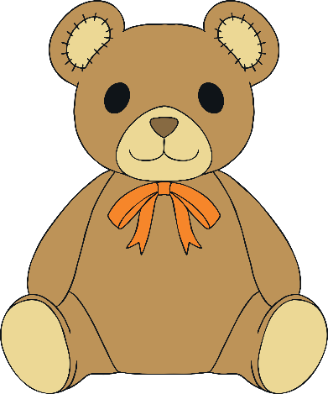
Making turns – a quarter turn anti-clockwise
The bear turns 1 of the 4 equal parts.
The bear might turn part of the whole turn.
The bear will turn a quarter of the whole turn anti-clockwise.

Slide 16
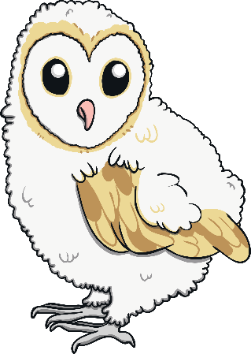
Making turns – a half turn clockwise
A half means there ae 2 equal parts.
The owl might turn part of the whole turn.
The owl will turn half of the whole turn clockwise.

Slide 17
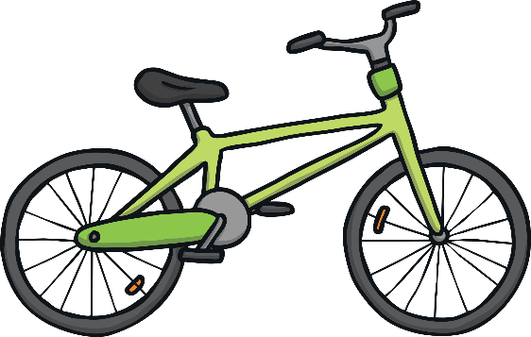
Making turns – a half turn anti-clockwise
Remember, turning left is anti-clockwise. Turning right
is clockwise
The bike might turn part of the whole turn.
The bike will turn half of the whole turn anti-clockwise.

Slide 18
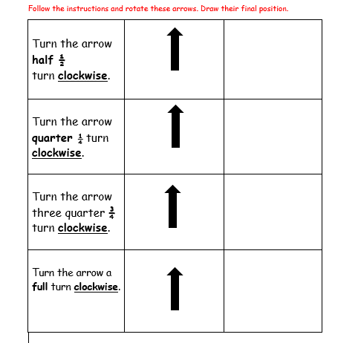
Day 3 TASK Today you can ALL try this – I have just made it clockwise turns today!

Slide 19
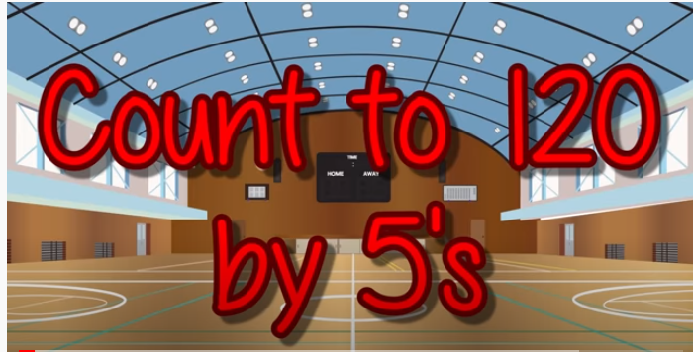
DAY 4 STARTER Click here do this exercise video whilst counting in 5s

Slide 20
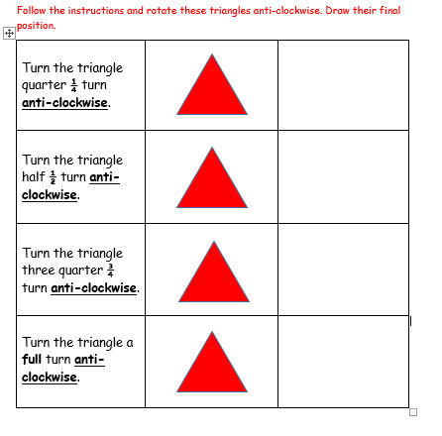
Day 4 TASK Yesterday we turned an arrow clockwise…..today we will think about turning a triangle anti-clockwise. PARENTS – please cut out a triangle if your child needs it and physically turn it.
Cut me out and rotate me!

Slide 21
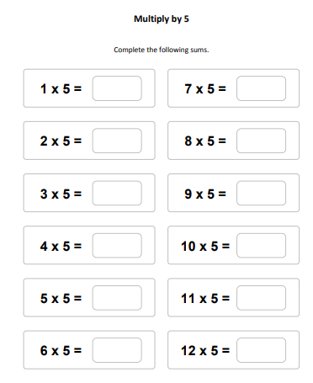
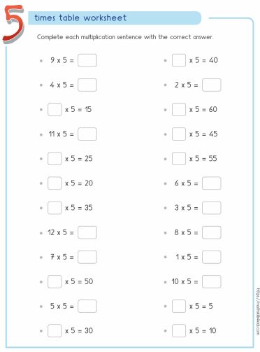
Day 5 Starters
5 times table song and then choose one of these sets of questions.

Slide 22
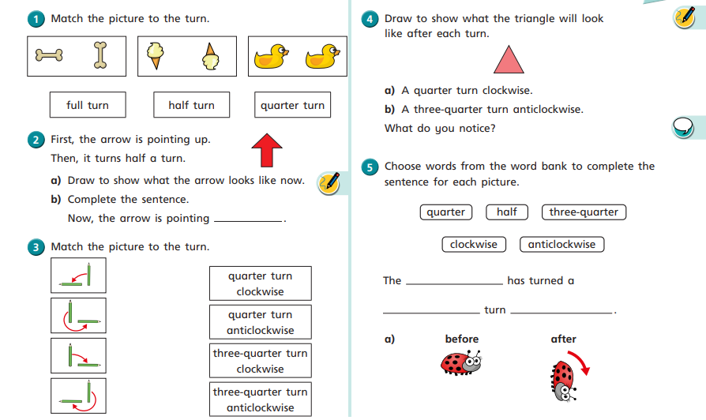
Day 5 TASK – Parents your child may need help or resources e.g. a pencil to physically turn
TIP
Use a real pencil

